Slide 1

Born-Again Multi-Task Networks for Natural Language Understanding
IZABELA-VALENTINA IANCU

Slide 2
Overview:
Introductory and overviews
1.1 NLP
1.2 BERT model key features
1.3 Multi-tasking Networks in NLP
2. BAM!
2.1 Knowledge Distillation
2.2 Dark knowledge
3. Results

Slide 3

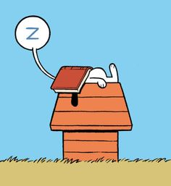

What’s all about
Back to basics:
we speak
we read
we write
all that using language

Slide 4
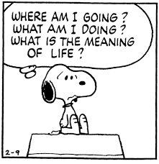
But that’s not all…
we think of the world around us
we dream
we make decisions and plans
all of that in natural language, i.e. in words
If we unlock the key to understanding how language works, we unlock the key to understanding how the human brain works

Slide 5
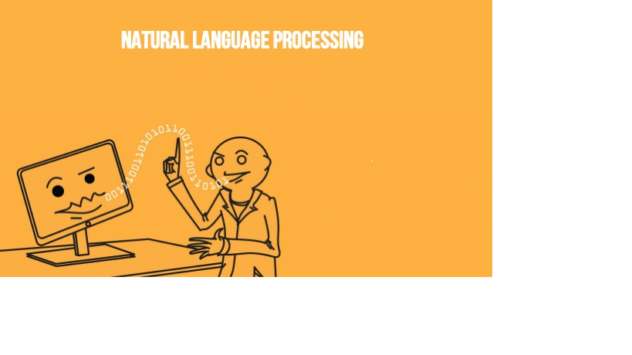
1. 1 What is NLP?
Study of interaction between computers and human language
NLP = Computer Science + AI + Linguistics
Identify the structure and meaning of words, sentences,
texts and conversations

Slide 6
Main categories of NLP tasks:
Text Classification Tasks – categorizing text into organized groups
Ex.: filtering spam emails, classifying documents based on dominant content, sentiment analysis

Slide 7
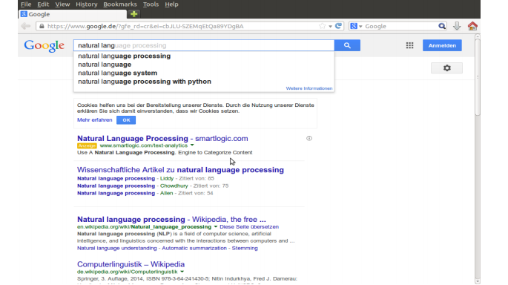
2. Word Sequence Tasks - predict next/previous word(s), text generation
Ex.: translation, chatbots, word prediction

Slide 8

3. Text Meaning Tasks - mapping of words based in meaning
Ex.: finding similar words, search engines, question answering

Slide 9
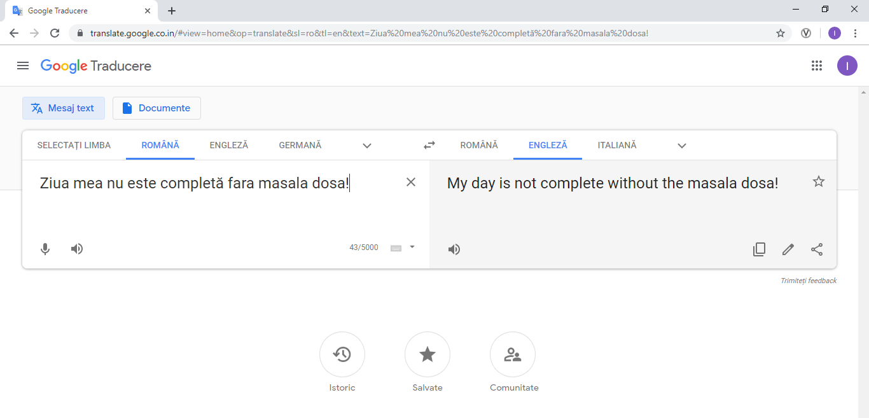
4. Sequence to Sequence Tasks - based on encoders and decoders -> context vectors -> semantic summary of input
Ex.: machine translation, summarization, simplification, Q&A systems

Slide 10

1.2 BERT Model

Slide 11
1.2 BERT Model
Developed by Google Research Team and released in 2018
BERT = Bidirectional Encoder Representations from Transformers
Why Bidirectional?
proposes new pre-training objective vs. unidirectional models that are efficiently trained by predicting each word conditioned on the previous words in the sentence, by training jointly on 2 tasks:
The “Masked Language Model” (MLM): the objective is to predict the original
word of a masked word based only on it’s context

Slide 12
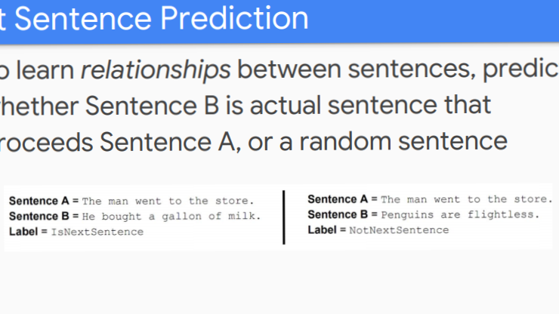
“Next Sequence Prediction” (NSP): prediction if a sentence follows
the previous or not, to learn relationships between sentences

Slide 13
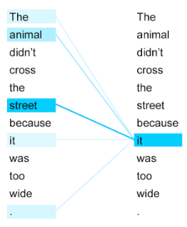
What are Transformers?
Encoder + Decoder + Self-Attention
Ex.:
Encoder + Decoder -> translating (non-native languages)
ENGLISH -> native language -> German
Self-Attention –> every word can ‘’see’’ the other words

Slide 14

Why everybody BERT
BERT advances the state of the art results on eleven different NLP tasks
Powerful: It is pre-trained on un-labeled text Wikipedia 2.5 billion words
Unified Architecture across different tasks: minimal difference between the pre-trained model and the fine-tuned one

Slide 15
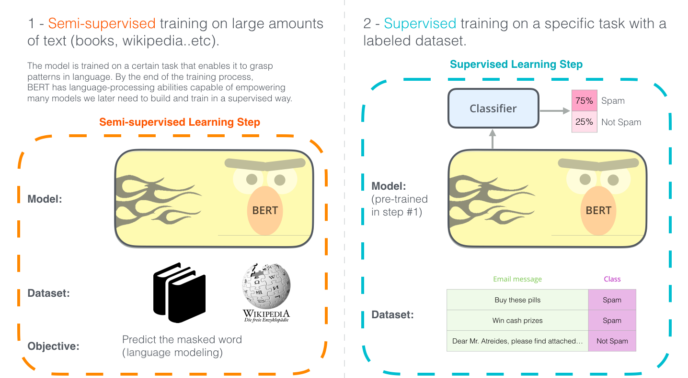

Slide 16
1.3 Multi-Tasking Networks in NLP
MOTIVATION: The human ability to understand language is general, flexible, and robust.
PROBLEM: most NLP models are designed for a specific task and struggle with
out-of-domain data
-> need for more unified model that can learn to execute a range of different linguistic
tasks in different domains
SOLUTION!!!!
MULTI-TASKING!

Slide 17
WHAT?
Multi-Tasking Learning = unites useful information contained in multiple related tasks to help improve learning efficiency and generalization performance of all the tasks.
HOW?
-> learns tasks in parallel while using a shared representation; what is learned for each task can help other tasks be learned better.

Slide 18
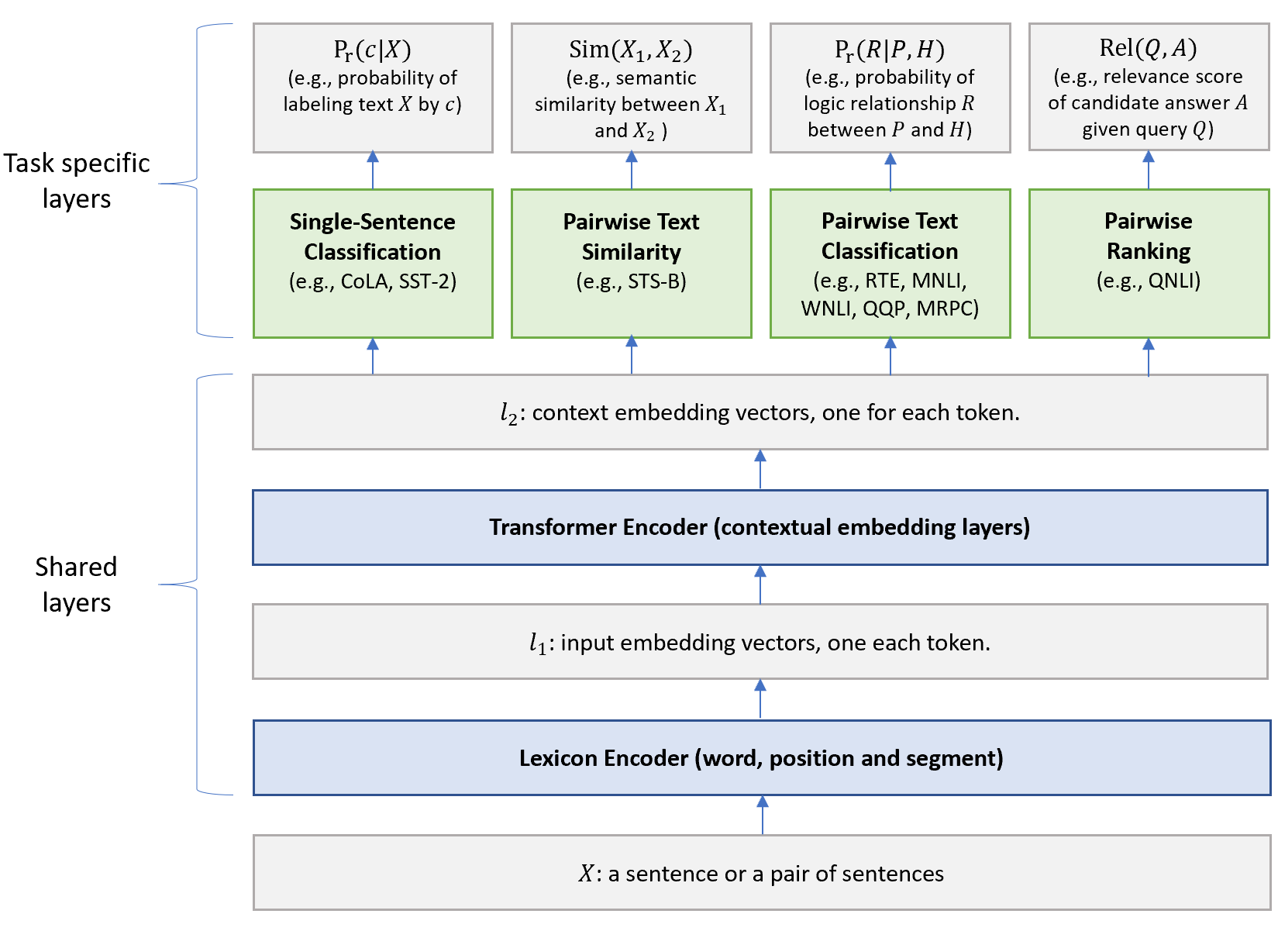

Slide 19
Multi-Task Learning PROS:
natural in learning: Multi-Task Learning is inspired by human learning activities
provides an effective way of gathering supervised data from many related tasks(not enough labeled data)
regularization effect via reducing overfitting to a specific task (universal learned representations across tasks)
faster to run and more interesting from the perspective of building general language-processing systems

Slide 20



2.
MOTIVATION
Multi-Tasking Learning:
Sequence-prediction tasks (tasks based on grammar): chunking and tagging, name error detection, etc.
Semantic tasks (the study of meanings in a language : Q&A, Text Generation) difficult to train and often perform worse than their single-task counterparts
BAM! SOLUTION → knowledge distillation where single-task models teach a multi-task model

Slide 21

2.1 Knowledge Distillation
"Teacher- Student" pattern: it transfers knowledge from a pre-trained “teacher” model to a “student” model by training the student to imitate the teacher’s outputs
Student model --> converge faster or with better predictions
Knowledge Distillation vs Standard Transfer Learning:
Transfer learning
the weights are transferred from a pre-trained network to a new network.
same networks architecture is needed.
the Student network is limited by the Teacher's capabilities.
Knowledge Distillation
the Student uses only the Teachers outputs, not it's weights.
different networks architectures can be used
the Student is not limited to only imitating the Teacher, because the Teacher’s outputs contain “dark knowledge”

Slide 22
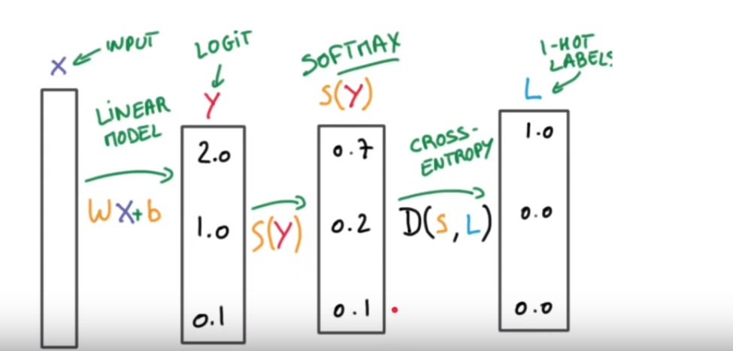
Normal Training

Slide 23
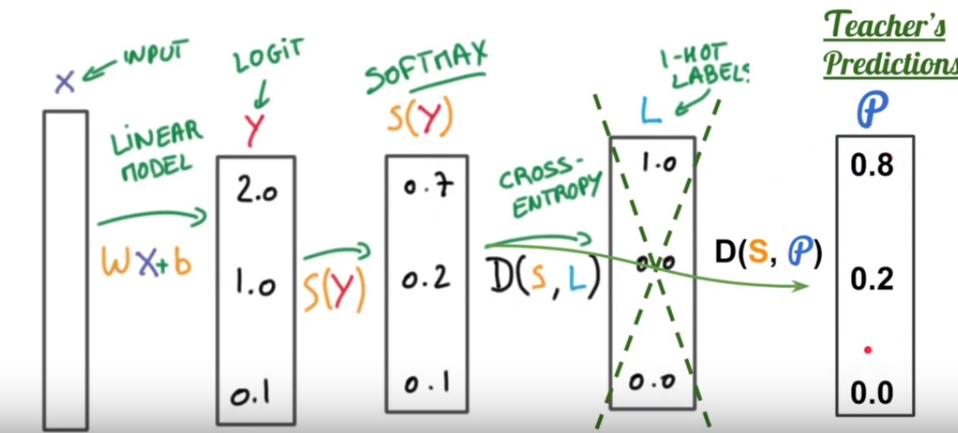
Training using Knowledge Distillation

Slide 24

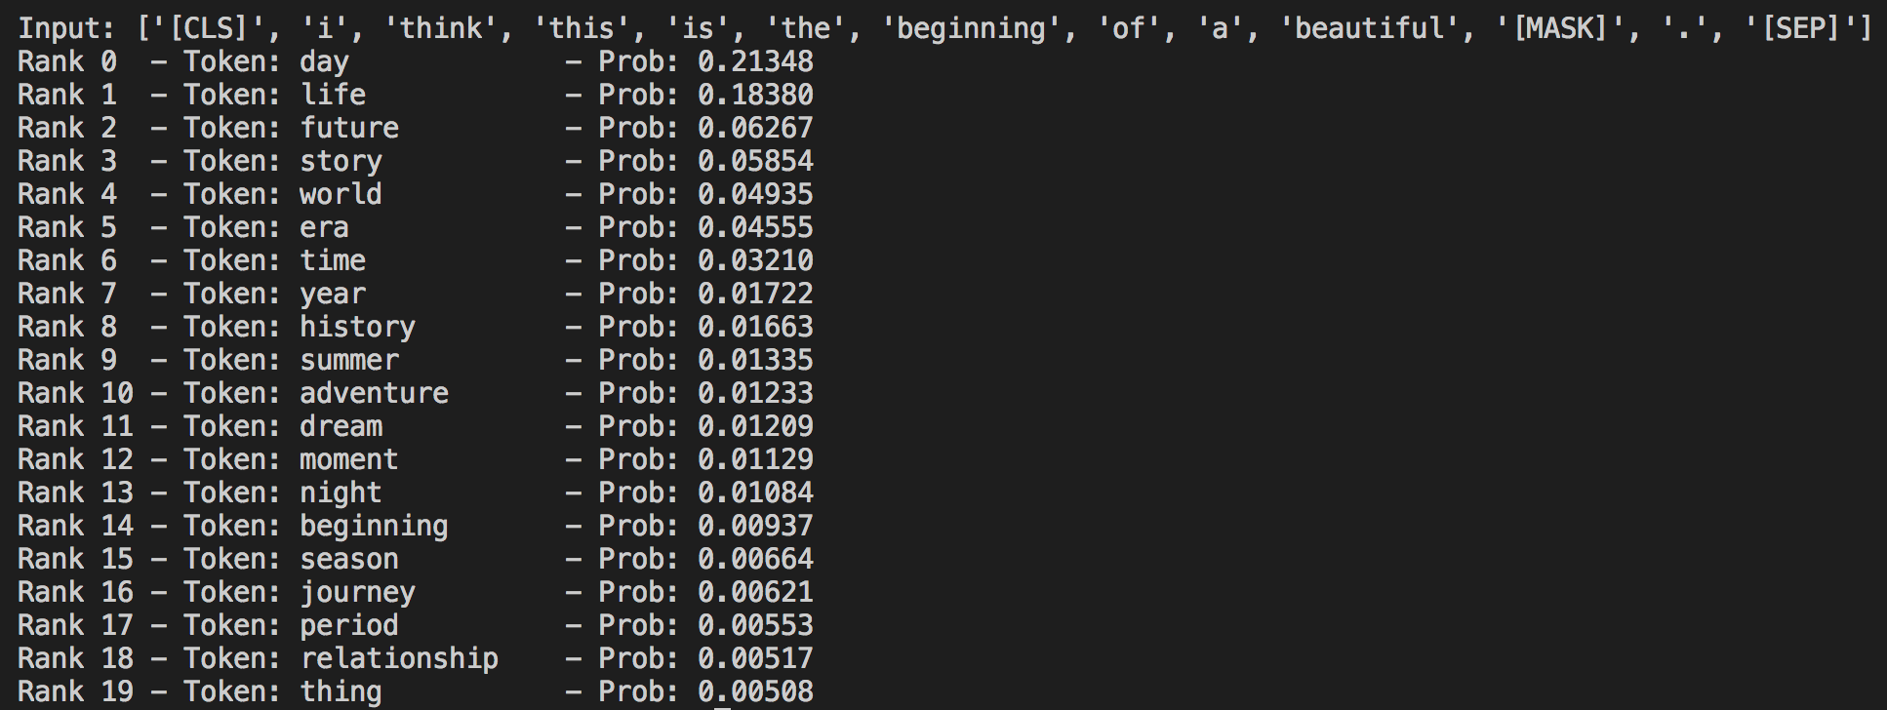
2.2 Dark Knowledge
Refers to the additional information encapsulated in the Teacher's predictions
Student gets the richest training signal as possible in early training
“almost-zero” probabilities reflect the model’s generalization capabilities

Slide 25
Born-Again ???
Student → Tea/cher → Master = Knowledge Distillation + Teacher Annealing
Student has the same architecture as the Teacher
Teacher Annealing = training the Student to match a mixture of the Teacher's predictions and the training data labels
( not only Teacher’s predictions)
The mixture changes it's value at each training step: A parameter which is linearly increasing from 0 to 1 as the training furthers, is introduced in the Student's loss function calculations.
Early training, our Student is relying on the Teacher's
As the training furthers, the parameter increases
Towards the end of training, the student will mostly rely on the training data's labels.
Student will be able to learn on his own using the additional information learned so far
Student becomes better than it’s Teacher

Slide 26
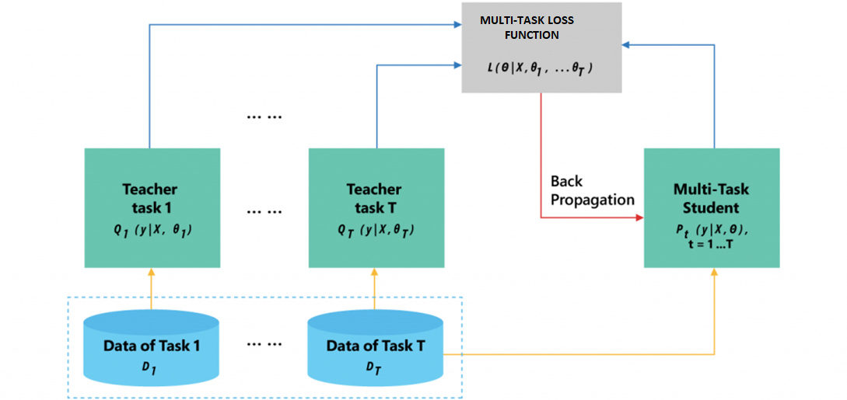
Pure Knowledge Distillation

Slide 27
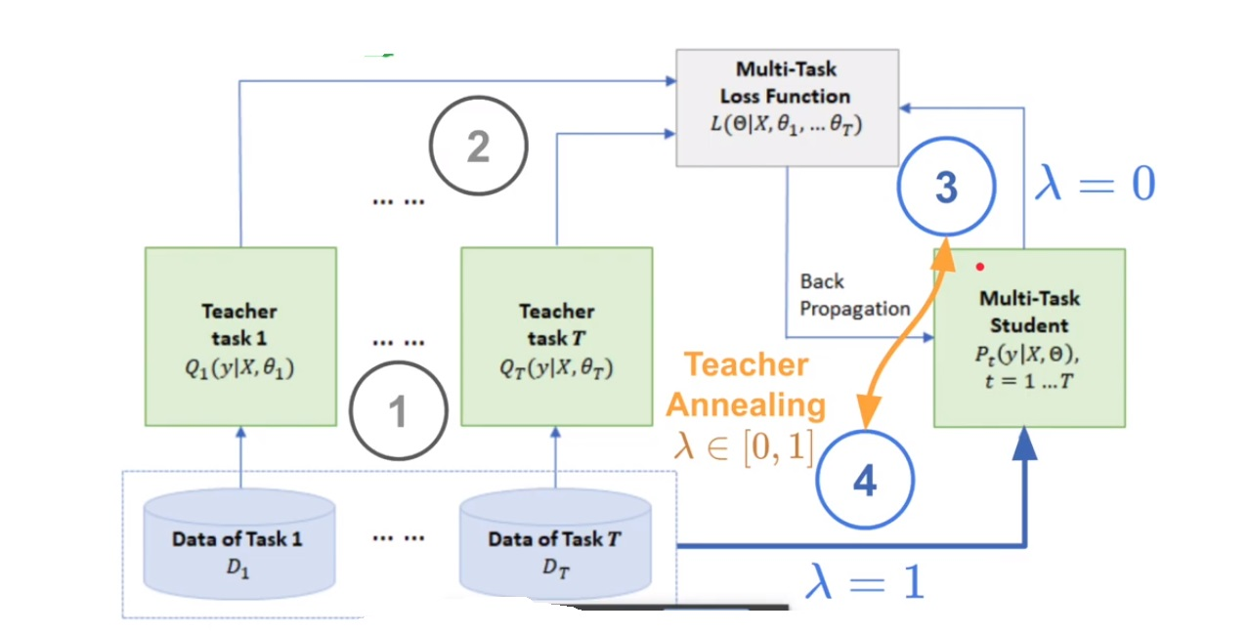
Knowledge Distillation + Teacher Annealing

Slide 28
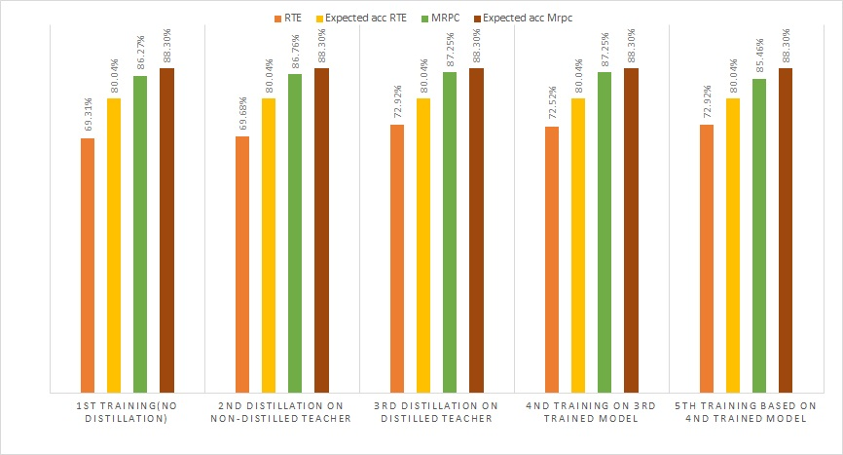
3. Results
Single-task model training

Slide 29
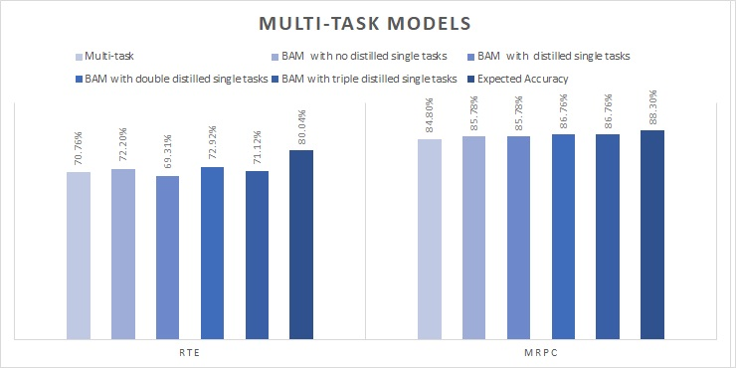
Multi-task model training

Slide 30

Thank you!

